Slide 1

INSTITUTE :UIE
DEPARTMENT: ALL ACADEMIC UNITS
Bachelor of Engineering (All Sections)
Subject Name and Code:
Engineering Physics 23SPH-141
Prepared by: Arminder Kaur, Assistant Prof. Physics
UNIT 2
CRYSTALLOGRAPHY & ULTRASONICS
DISCOVER . LEARN . EMPOWER

Slide 2
COURSE OBJECTIVES
The course is designed to make the students industry ready to contribute in the growing demand of the industry at local, national and international level.
It will make the students competent to understand basic concepts and applications of advanced engineering physics and apply its principles in their respective fields at global platform.
It will enhance the skill level of the students and shall make them preferred choice for getting employment in industry and research labs.
It will give thorough knowledge of the discipline to enable students to disseminate knowledge in pursuing excellence in academic areas.

Slide 3
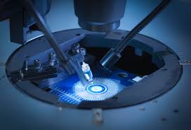
Course Outcomes
CO Number | Title On completion of this course, the students are expected to learn | Level
CO1 | Quote the basic fundamental concepts of lasers, optical fibres, crystallography, ultrasonic oscillations, semiconductor physics, quantum mechanics and nanotechnology. | Remember, Understand
CO2 | Demonstrate the working of various lasers, fibre components, semiconductor devices; explain the behaviour of crystalline solids, quantum and nano-scale systems. | Understand
CO3 | Solve problems by applying principles related to lasers, fibres, semiconductors, oscillations, quantum and nanoscience. | Applying
CO4 | Compare various lasers and fibres, semiconducting devices, crystalline materials, structures at quantum and nanoscale on the basis of their properties for industrial applications. | Analyze
CO5 | Develop various systems using lasers, fibres, semiconductors and nanomaterials for futuristic applications. | Design
Figure 1.1 Manufacturing of semiconductor [1]

Slide 4
INTRODUCTION
UNIT -2
CHAPTER 1
CRYSTALLOGRAPHY & ULTRASONICS
TOPIC: Basic terms, types of crystal systems, Bravais lattices

Slide 5
LECTURE OBJECTIVE
Students will learn about crystallography branch and its importance.
Students will understand how arrangements effect the properties of materials.
Students will learn basic terms related to crystallography

Slide 6


CONTENT
INTRODUCTION TO CRYSTALLOGRAPHY
TYPES OF MATTER-SOLID, LIQUID, GAS
TYPES OF SOLIDS
PROPERTIES
CRYSTAL STRUCTURE
SPACE LATTICE
BASIS
UNIT CELL
BRAVAIS LATTICE

Slide 7
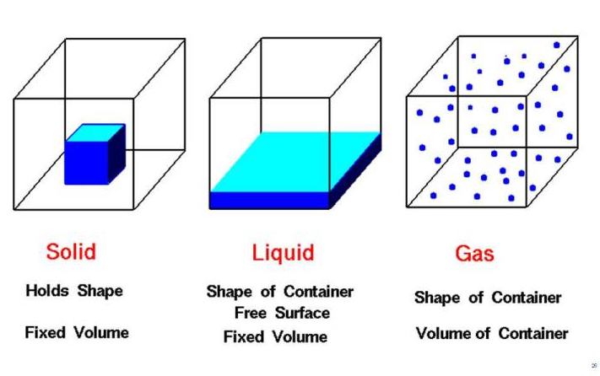
TYPES OF MATTER
Solids
In the solid state the vibrating particles form a regular pattern. This explains the fixed shape of a solid.
Liquids
In a liquid the particles still touch their neighbors but they move around, sliding over each other.
Gases
In the gas state, widely-spaced particles move around randomly. This explains why you can compress gases.
TYPES OF PHYSICAL STATES
Figure 1.2 Types of matter and their basic properties [2]
Notes:
Solids
In the solid state the vibrating particles form a regular pattern. This explains the fixed shape of a solid and why it can’t be compressed or poured.
Liquids
In a liquid the particles still touch their neighbours but they move around, sliding over each other. This is why you can pour, but not compress, a liquid.
Gases
In the gas state, widely-spaced particles move around randomly. This explains why you can compress gases and why they flow.
Plasma
like a gas, plasma has no defined shape or volume. It can expand to fill a container. However, the particles in plasma are ionized (carry an electric charge) and very widely separated from each other. Examples of plasma include:
Lightning
Neon sign
Earth’s ionosphere
Sun’s corona
Aurora
Static electricity

Slide 8
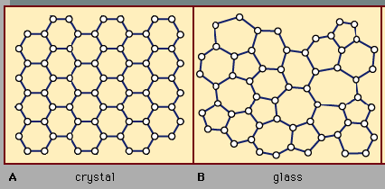
TYPES OF SOLIDS
A crystal or crystalline solid is a solid material whose constituents are arranged in a highly ordered microscopic structure, forming a crystal lattice that extends in all directions. For e.g. metals
An amorphous or non-crystalline solid is a solid that lacks the long-range order that is characteristic of a crystal for e.g. Glass-Ceramics.
Figure 1.3 describing crystal and amorphous solid structure [3]
Notes:
A crystal or crystalline solid is a solid material whose constituents are arranged in a highly ordered microscopic structure, forming a crystal lattice that extends in all directions. For e.g metals -many ceramics -some polymers
an amorphous or non-crystalline solid is a solid that lacks the long-range order that is characteristic of a crystal for e.g. Glass-Ceramics
A crystal or crystalline solid is a solid material whose constituents are arranged in a highly ordered microscopic structure, forming a crystal lattice that extends in all directions. For e.g metals -many ceramics -some polymers
an amorphous or non-crystalline solid is a solid that lacks the long-range order that is characteristic of a crystal for e.g. Glass-Ceramics
A crystal or crystalline solid is a solid material whose constituents are arranged in a highly ordered microscopic structure, forming a crystal lattice that extends in all directions. For e.g metals -many ceramics -some polymers
an amorphous or non-crystalline solid is a solid that lacks the long-range order that is characteristic of a crystal for e.g. Glass-Ceramics

Slide 9

PROPERTIES
Geometry: Crystalline Solids – Particles are arranged in a repeating pattern. They have a regular and ordered arrangement resulting in a definite shape. Amorphous Solids – Particles are arranged randomly. They do not have an ordered arrangement resulting in irregular shapes.
Melting Points Crystalline Solids – They have a sharp melting points. Amorphous Solids – They do not have sharp melting points. The solid tends to soften gradually over a temperature range.
Isotopism: Crystalline Solids – Anisotropic in nature. i.e., the magnitude of physical properties (such as refractive index, electrical conductivity, thermal conductivity etc.) is different along with different directions of the crystal. Amorphous Solids – Isotropic in nature. i.e., the magnitude of the physical properties is the same along with all directions of the solid.

Slide 10
PROPERTIES
Cleavage Property Crystalline Solids – When cutting with a sharp edge, the two new halves will have smooth surfaces. Amorphous Solids – When cutting with a sharp edge, the two resulting halves will have irregular surfaces.
Rigidity: Crystalline Solids – They are rigid solids and applying mild forces will not distort its shape. Amorphous Solids – They are not rigid, so mild effects may change the shape.

Slide 11
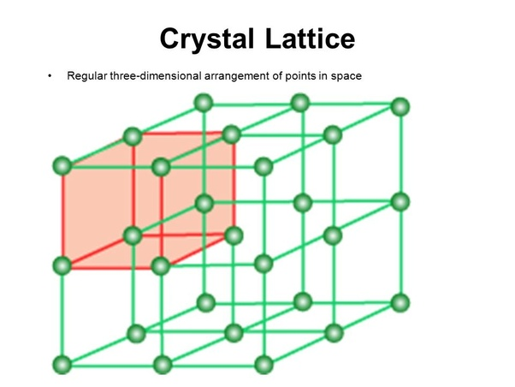
FORMATION OF CRYSTAL STRUCTURE
Space lattice + basis = crystal structure
Space lattice
Basis
Figure 1.4 crystal structure consisting basis and space lattice [4]
Notes:
Space lattice-a regular, indefinitely repeated array of points in three dimensions in which the points lie at the intersections of three sets of parallel equidistant planes.
Basis- every lattice point with an assembly of atoms or molecules or ions, which are identical in composition, arrangement and orientation, is called as the basis

Slide 12
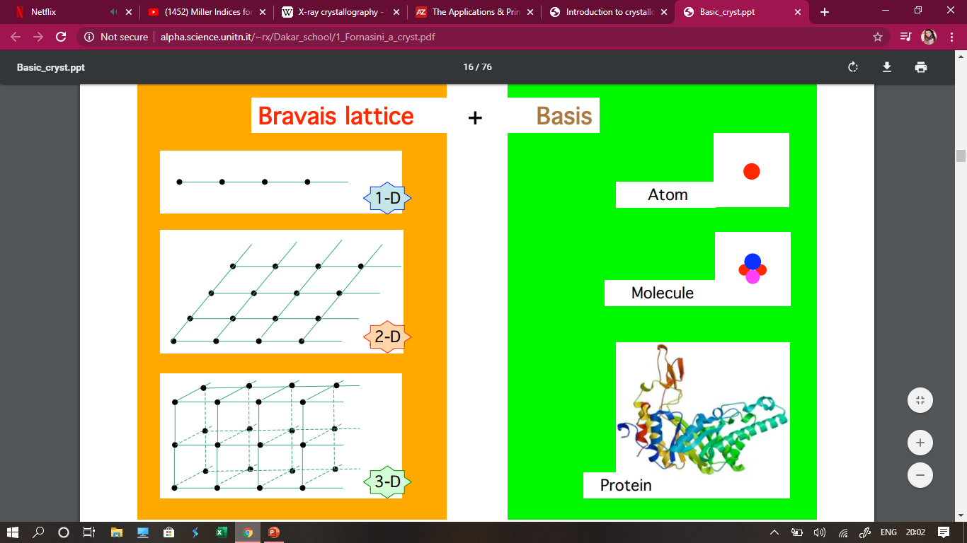
Space lattice
SPACE LATTICE- a regular, indefinitely repeated array of points in three dimensions in which the points lie at the intersections of three sets of parallel equidistant planes.
BASIS-The crystal basis is defined by the type, number, and arrangement of atoms inside the unit cell.
Figure 1.5 space lattice and basis [5]

Slide 13
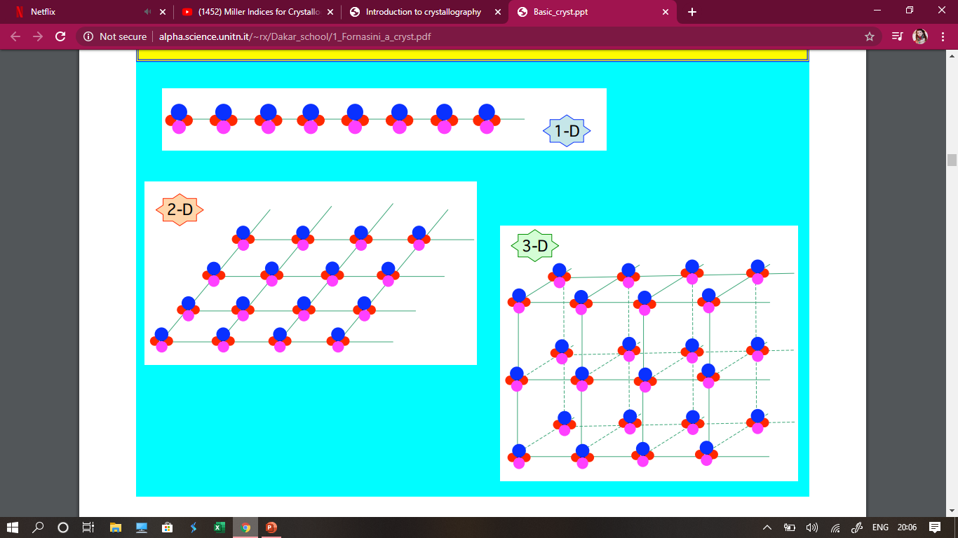
CRYSTAL STRUCTURE
Figure 1.6 crystal structure by joining space lattice and basis [6]

Slide 14
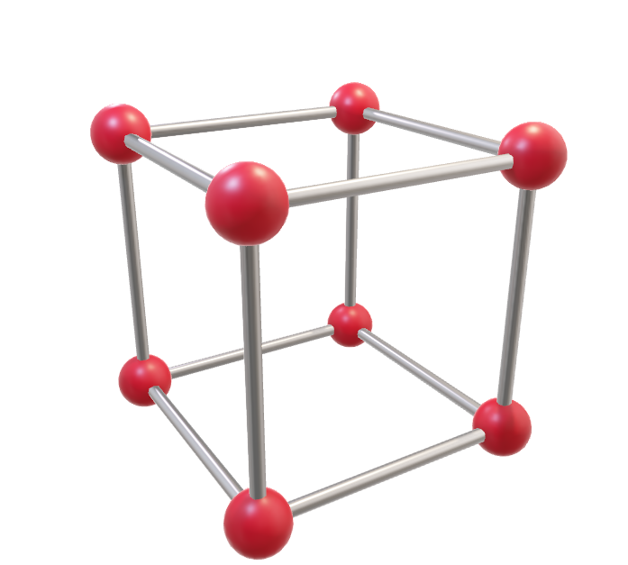
UNIT CELL
The smallest group of atoms which has the overall symmetry of a crystal, and from which the entire lattice can be built up by repetition in three dimensions.
Figure 1.7 unit cell [7]
Notes:
UNIT cell- The simplest repeating unit in a crystal is called a unit cell
Primitive unit cell – The cell which is having minimum volume. For e.g Simple cubic
Non primitive unit cell- The cell is having relatively larger volume. For e.g FCC, BCC

Slide 15
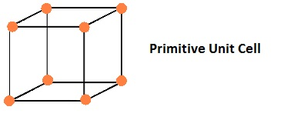
PRIMITIVE UNIT CELL
A primitive cell is a unit cell that contains exactly one lattice point. It is the smallest possible cell. If there is a lattice point at the edge of a cell and thus shared with another cell, it is only counted half. Accordingly, a point located on the corner of a cube is shared by 8 cubes.
Figure 1.8 primitive unit cell [7]

Slide 16
NON-PRIMITIVE CELL
Non-primitive cells are of three kinds:
end-centered : an extra lattice point is centered in each of two opposing faces of the cell
face-centered : an extra lattice point is centered in every face of the cell
body-centered : an extra lattice point is centered in the exact middle of the cell
They have larger volume than primitive unit cell.

Slide 17
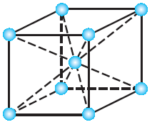
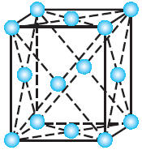
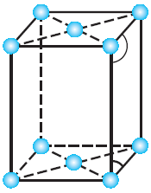
NON-PRIMITIVE UNIT CELL
Figure 1.9 Body centred cell [8]
Figure 1.10 Face centred cell [8]
Figure 1.11 end centred cell [8]

Slide 18
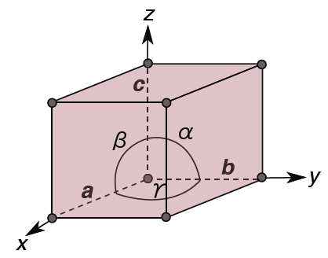
LATTICE PARAMETERS
6 parameters
Length of axis along x, y, z axis written as a, b, c
Angle between y and z axis is α
Angle between x and z axis is β
Angle between x and y axis is γ
Figure 1.12 parameters of unit cell [9]

Slide 19
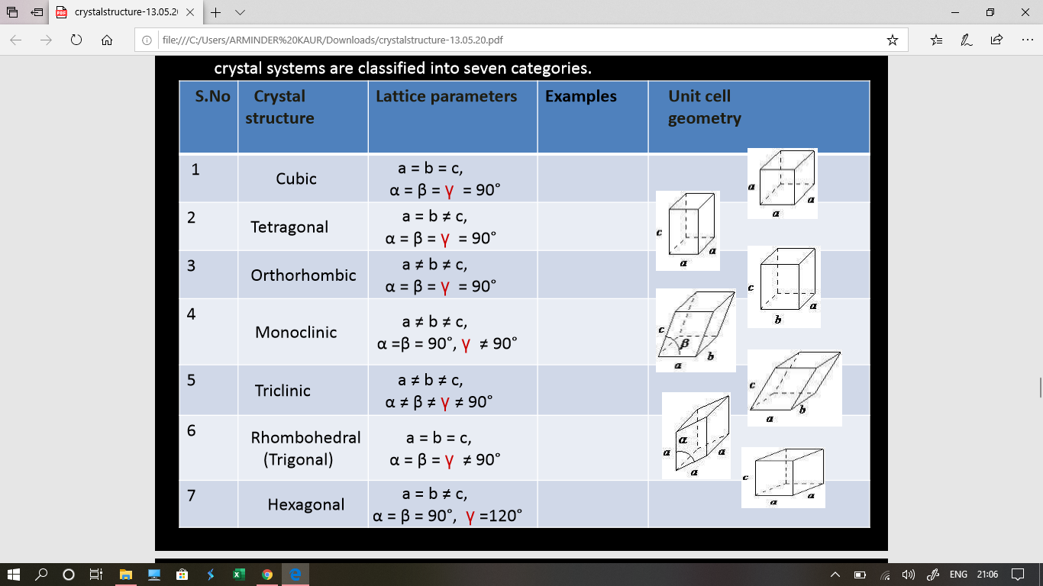
CRYSTAL SYSTEMS
Figure 1.13 Crystal systems [8]

Slide 20
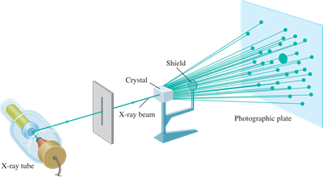
APPLICATIONS IN ENGINEERING
X-ray crystallography is a powerful non-destructive technique for determining the molecular structure of a crystal.
It was primarily used in fundamental science applications for determining the size of atoms, the lengths and different types of chemical bonds, the atomic arrangement of materials.
Figure 1.14 x-ray experiment set up [10]

Slide 21
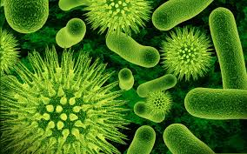
APPLICATIONS
The difference between materials at the atomic level, and for determining the crystalline integrity, grain orientation, grain size, film thickness and interface roughness of alloys and minerals.
It is now often used to identify the structure of various biological materials, vitamins, pharmaceutical drugs, thin-film materials and multi-layered materials. It has become one of the standard ways of analyzing a material.
Figure 1.15 bacteria image [11]

Slide 22
LIMITATIONS OF X-Ray DIFFRACTION
As the crystal's repeating unit, its unit cell, becomes larger and more complex, the atomic-level picture provided by X-ray crystallography becomes less well-resolved for a given number of observed reflections.
If the diffraction pattern is not clear, then the sample may not be pure and will be purified at this point. But other factors can prevent a diffraction pattern from being generated including a too-small sample (needs to be at 0.1 nm in each dimension), an irregular crystal structure, and the presence of any internal imperfections—such as cracks—in the crystal.

Slide 23
FREQUENTLY ASKED QUESTIONS
Justify use of X-Ray to study crystal structure.
Is there any term like polycrystalline?
Differentiate between crystalline and amorphous materials.
Explain non primitive unit cell
Define unit cell, space lattice, basis.
How many crystal systems are there and describe them.
Predict the unit cell for NaCl

Slide 24
SUMMARY
Crystallography is a field of science that deals with arrangements of atoms.
There are three types of matter of state.
Crystalline materials are those have periodic arrangements of atoms.
Space lattice and basis form complete crystal.
Unit cell is smallest repeating unit in crystals.
There are 6 parameters of one unit cell.
There are 7 crystal systems and 14 Bravais lattice.

Slide 25
REFERENCES
https://ocw.mit.edu/courses/materials-science-and-engineering/3-091sc-introduction-to-solid-state-chemistry-fall-2010/amorphous-materials/21-introduction-to-glasses/
https://www3.nd.edu/~amoukasi/CBE30361/Lecture__crystallography_A.pdf
http://www.uvm.edu/~gdrusche/Classes/GEOL%20110%20-%20Earth%20Materials/2010%20files/Lecture%2011%20-%20Crystallography.pdf
https://www.slideshare.net/AvinashAvi110/crystallography-125579803
http://ctc.xmu.edu.cn/jiegou/ppt/chapter7.pdf

Slide 26
REFERENCE BOOKS
http://indico.ictp.it/event/a10148/session/22/contribution/16/material/0/0.pdf
http://www.teqipiitk.in/workshop/2016/xrd/ppt/Prof%20Rajesh/crystallography.pdf
http://users.encs.concordia.ca/~mmedraj/TMG-Library/books/Crystallography_and_the_World_of_Symmetry.pdf
http://alpha.science.unitn.it/~rx/Dakar_school/1_Fornasini_a_cryst.pdf
Malik H.K, Singh A.K. (2011) Engineering Physics, TMH, New Delhi. ISBN: 9780070671539
T2. Beiser A. (2002) Concepts of Modern Physics, McGraw Hill Education. ISBN: 9780070495531

Slide 27
REFERENCE VIDEOS
https://study.com/academy/lesson/unit-cell-lattice-parameters-cubic-structures.html
https://nptel.ac.in/courses/104/106/104106093/
https://www.coursera.org/lecture/materials-science/crystallography-and-the-electron-microscope-YhPAB
https://www.youtube.com/watch?v=yooD_MZgQN4
https://www.youtube.com/watch?v=cm9W10Kg8q4
https://www.youtube.com/watch?v=2KWjYQnHDKA
https://www.youtube.com/watch?v=6c6ItfyiNcs

Slide 28
IMAGES REFERENCES
[1] https://fortune.com/2020/06/30/america-tech-semiconductor-manufacturing-investment/
[2] https://www.grc.nasa.gov/www/k-12/airplane/state.html
[3] https://www.britannica.com/science/amorphous-solid
[4] https://www.pngwing.com/en/free-png-yywbt
[5] https://users.aber.ac.uk/ruw/teach/334/bravais.php
[6] https://www.uio.no/studier/emner/matnat/fys/MENA3100/v18/leture-slides/introduction-to-crystallography.pdf
[7] https://www.examfear.com/notes/Class-12/Chemistry/The-Solid-State/1060/Primitive-Unit-Cells.html
[8] https://thefactfactor.com/facts/pure_science/chemistry/physical-chemistry/bravais-lattices/7443/
[9] https://www.doitpoms.ac.uk/tlplib/crystallography3/parameters.php
[10] https://www.mooreanalytical.com/x-ray-diffraction-xrd/
[11] https://www.medicinenet.com/e_coli__0157h7/article.html

Slide 29
THANK YOU
For queries
Email: arminder.uis@cumail.in

